Slide 1
WWDC18 - Session 703 Introducing Create ML
Marvin Lin

Slide 2
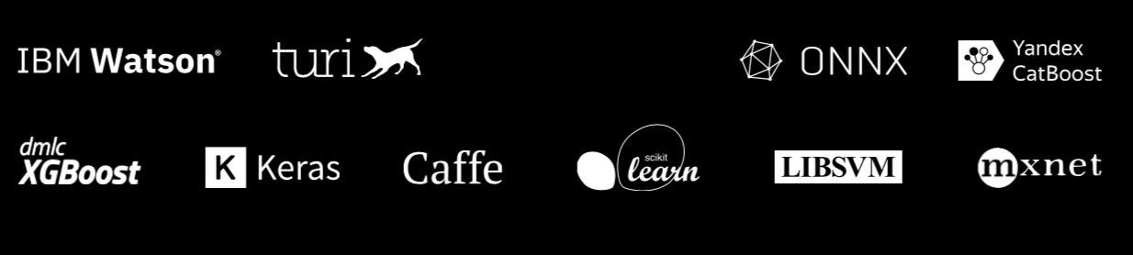
Frameworks of Machine Learning

Slide 3
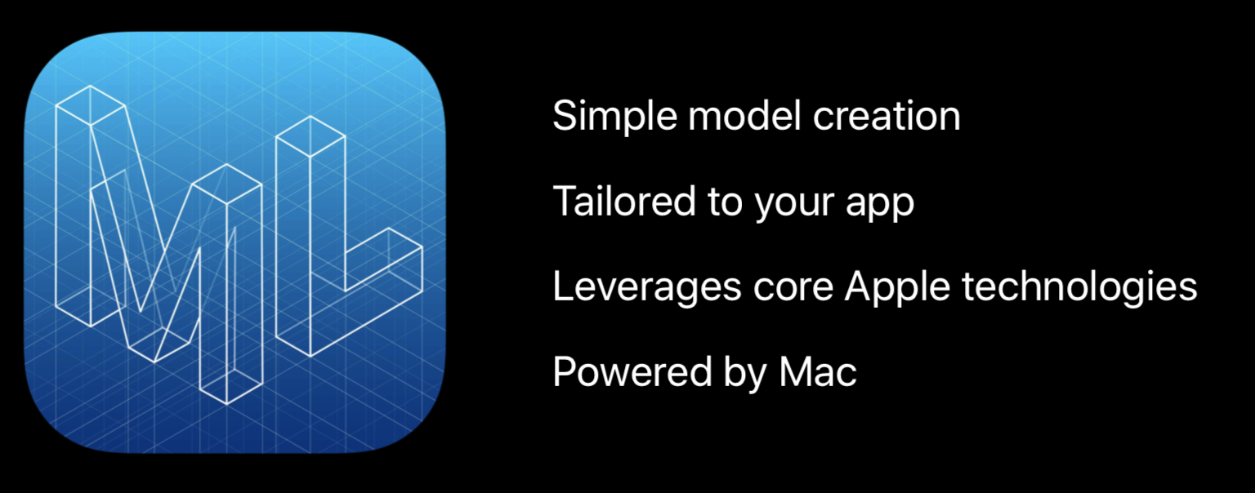
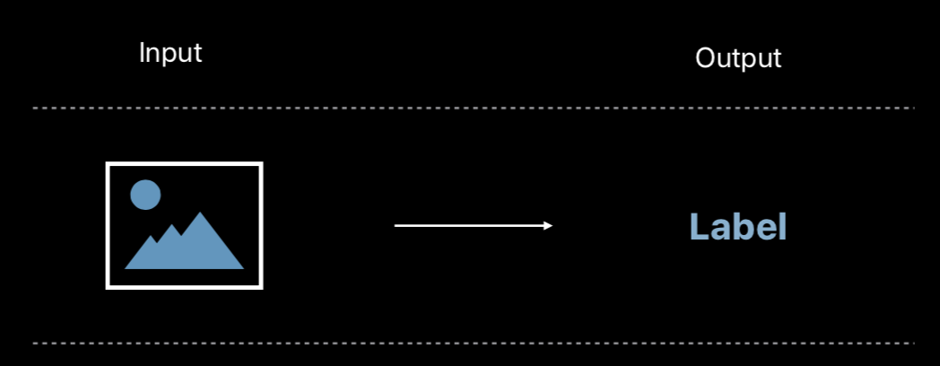
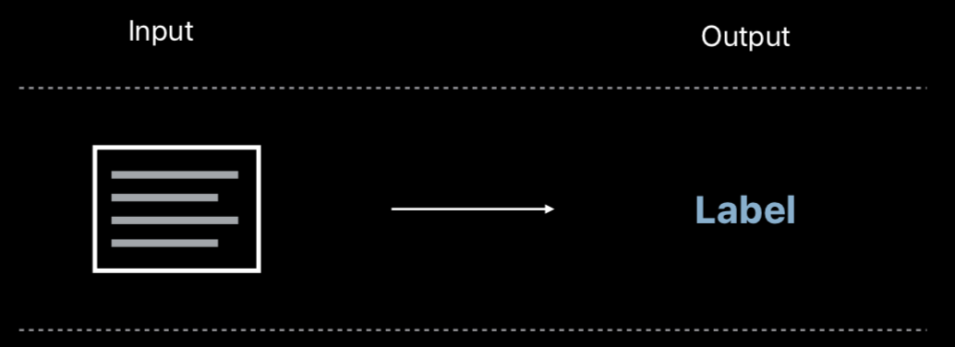
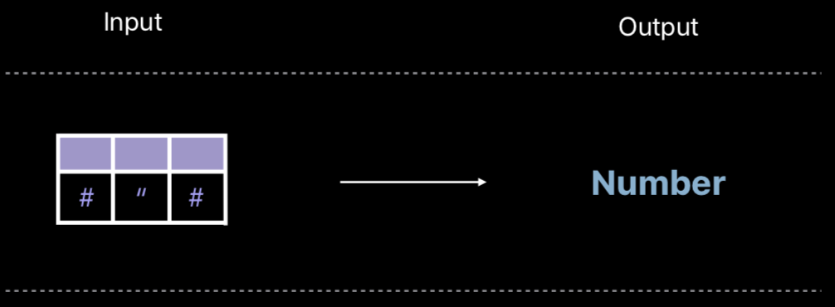
Image Classifier
Natural Language Classifier
Tabular Data

Slide 4
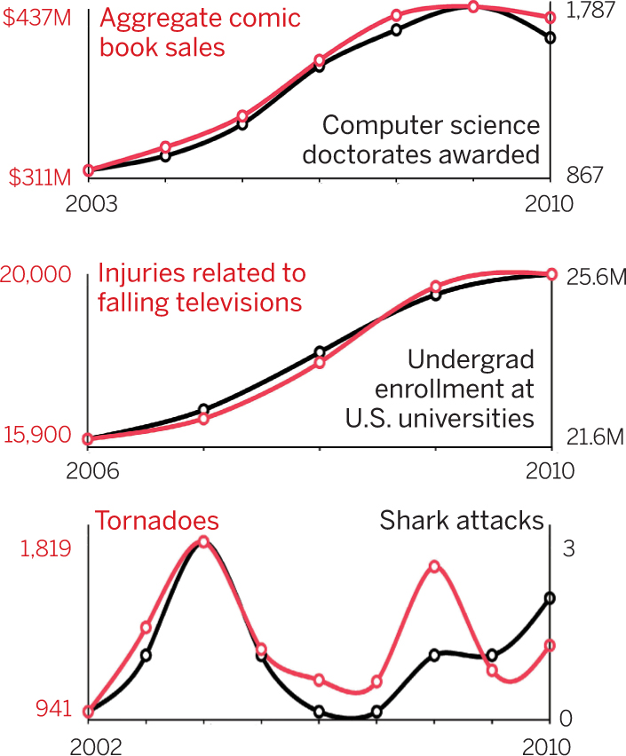
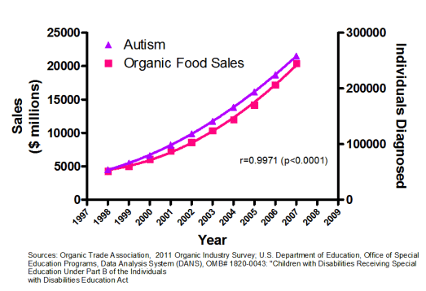
Correlation does not imply causation
Even the correlation coefficient as high as 0.99, these two group might not have any relationship.

Slide 5
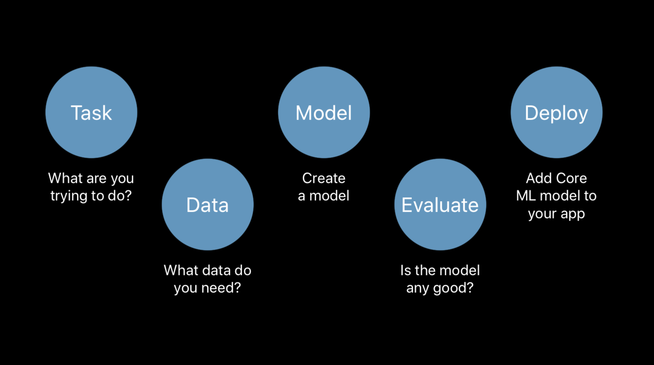
5 steps to build a ML Model

Slide 6
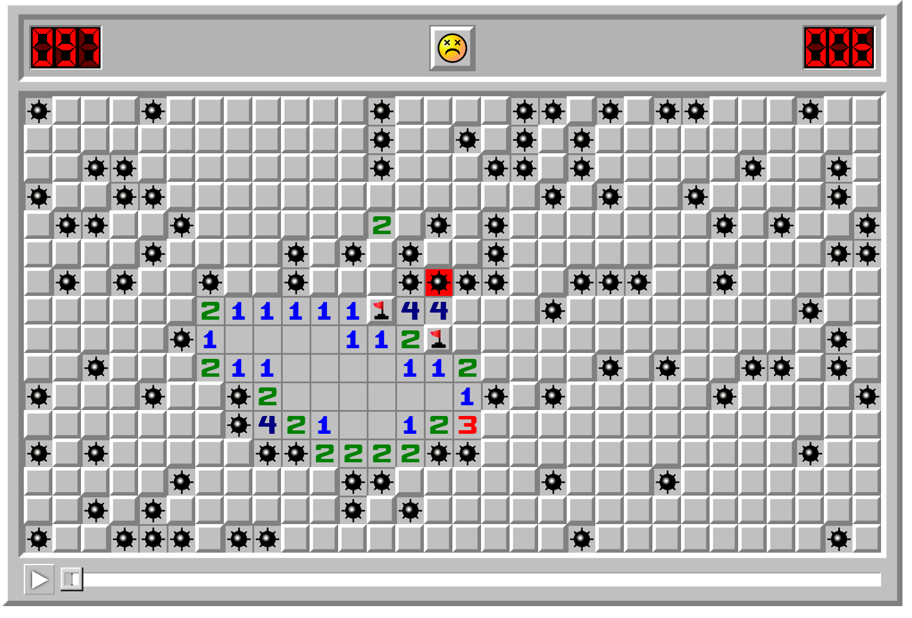
Build an App with beta framework is like this
Solution 1: Apple Developer Forum
Solution 2: AppCoda
Solution 3: Ray Wenderlich

Slide 7
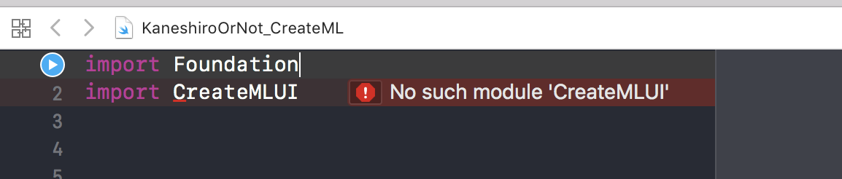
Some error might occur with CreatML
Playground can’t find the module
You must use MacOS template on Playground, otherwise you can’t build a model from it.

Slide 8
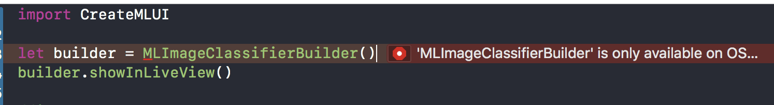
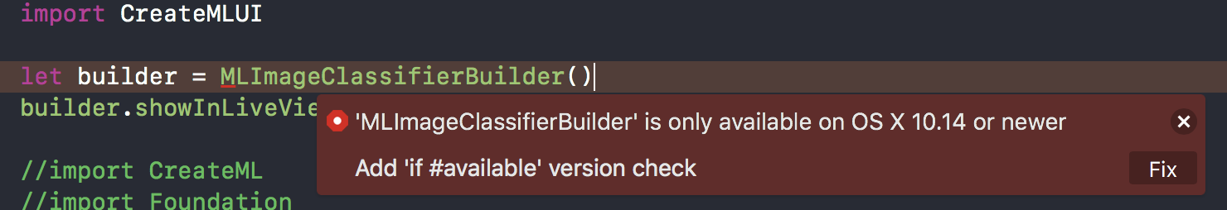
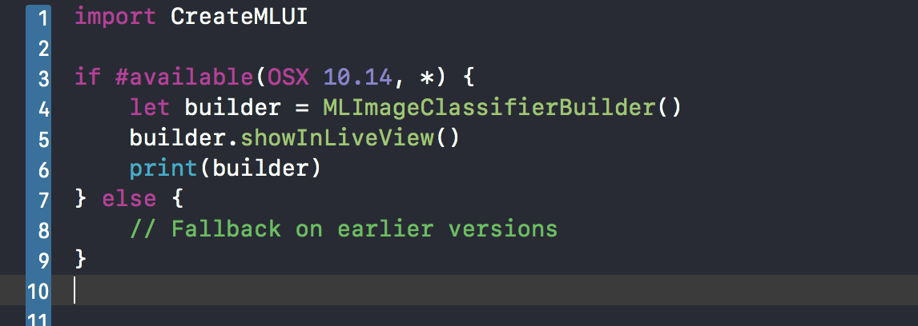
Some error might occur with CreatML- Cont’d

Slide 9
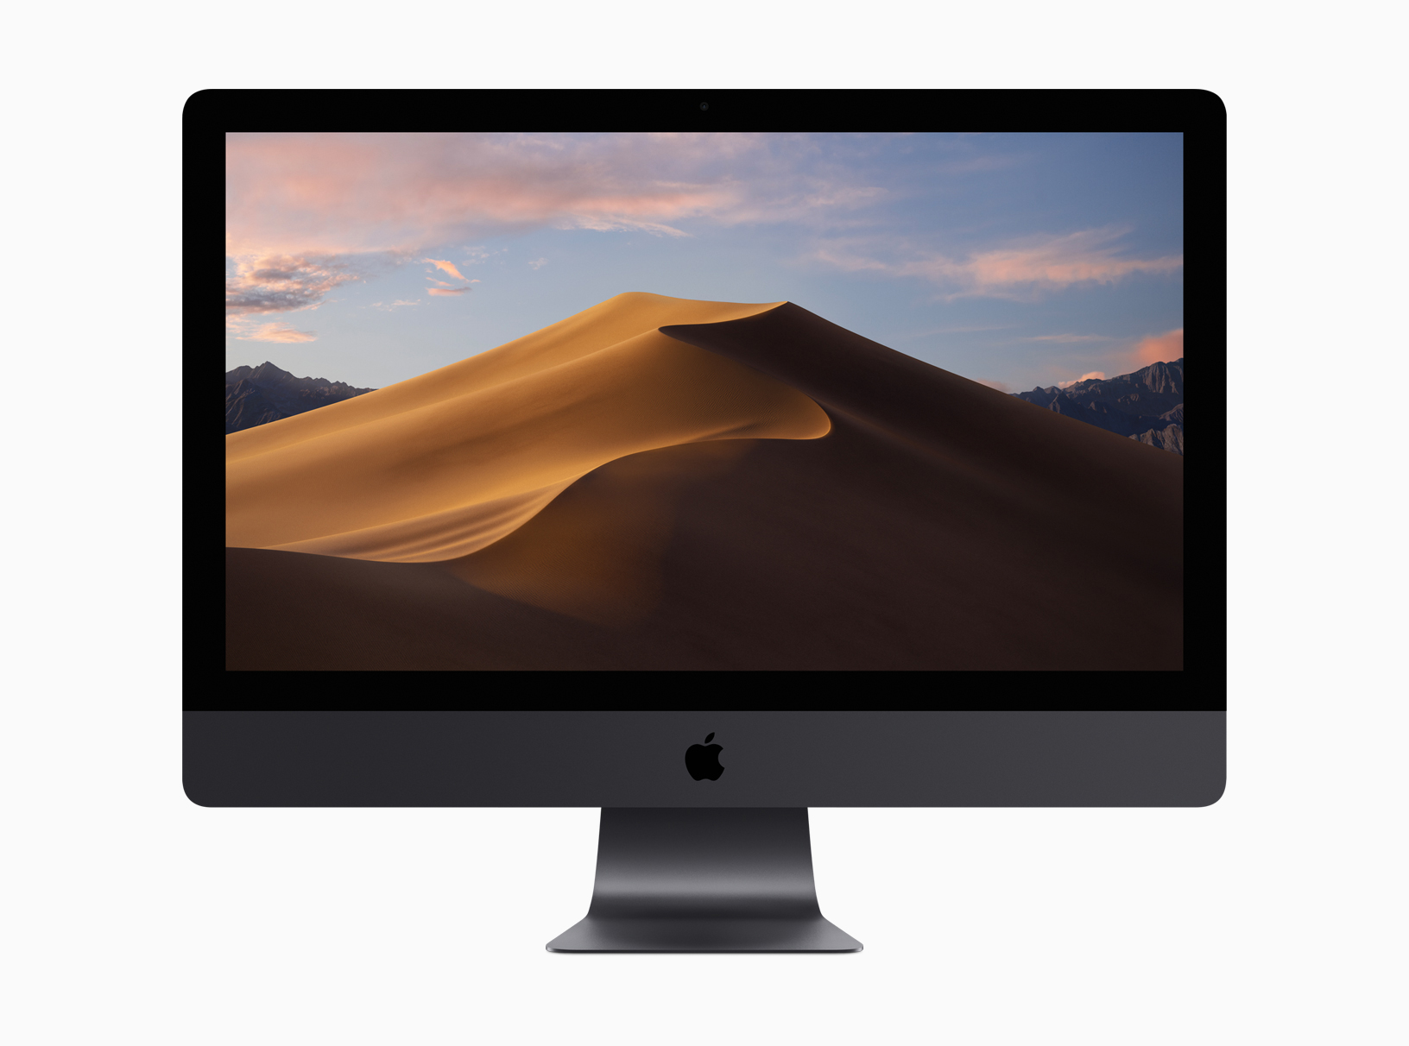
Upgrade to Mojave
Step 1. Using Time Machine to backup your files.
Step 2. Upload projects to GitHub.
Step 3. Zip and encode projects and upload to Cloud Driver.
https://www.apple.com/macos/mojave-preview/

Slide 10
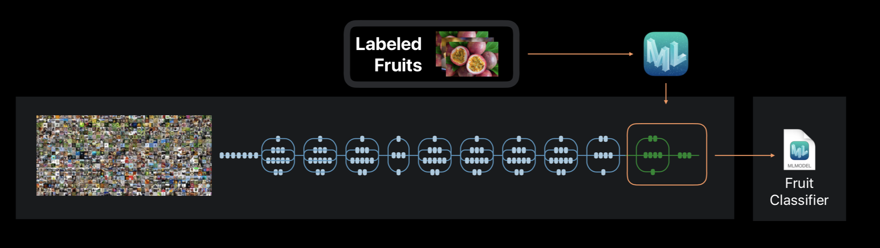
Image Classifier
Apple’s ML is based on a basic classifier, this let you can produce a model within minutes and from small training data.

Slide 11
Demo App
Judge the person is Kaneshiro or not?
Recognizing banana and apple

Slide 12
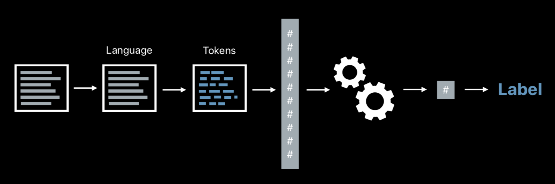
Basic NLP process
Raw Data

Slide 13
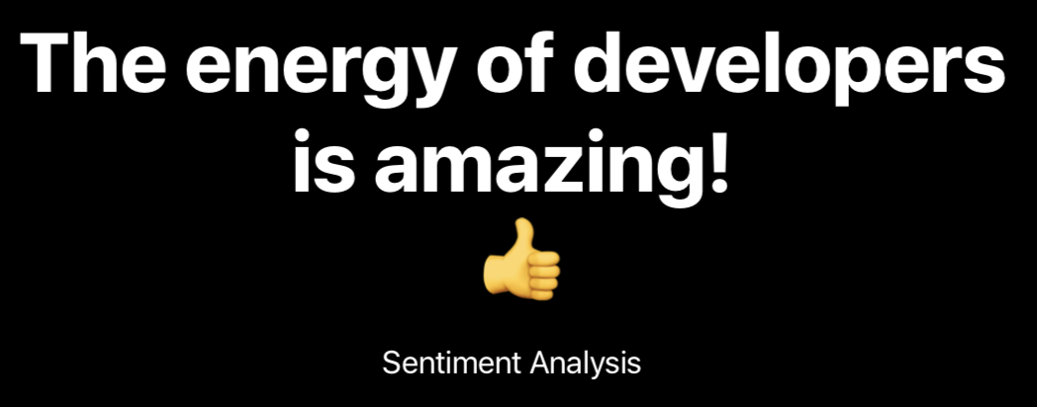
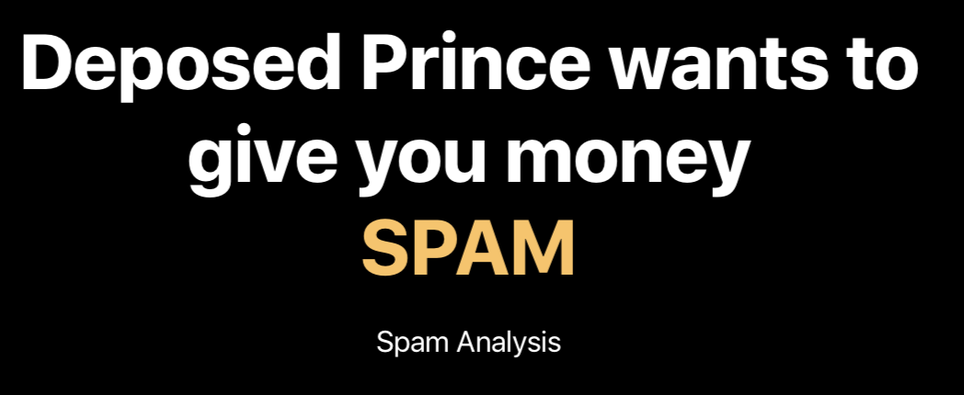
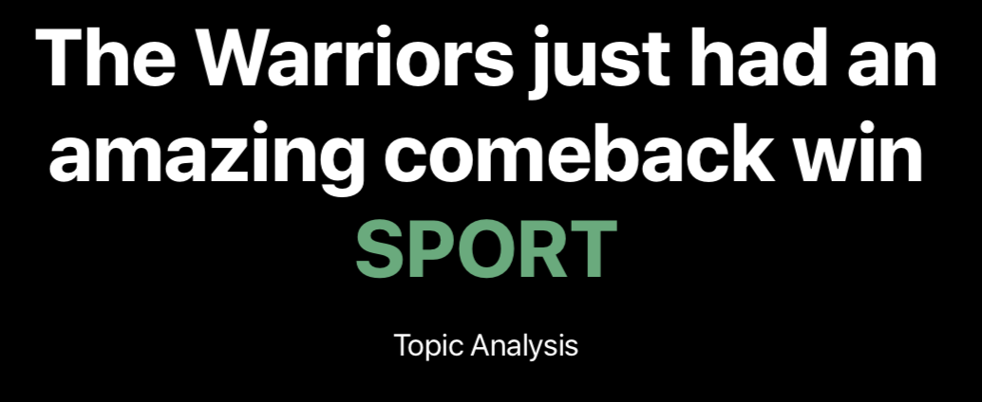
NLP Classifier in Create ML
Sentiment Analysis
Spam Analysis
Topic Analysis

Slide 14
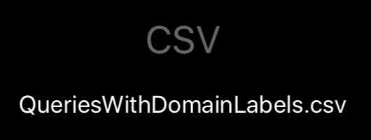
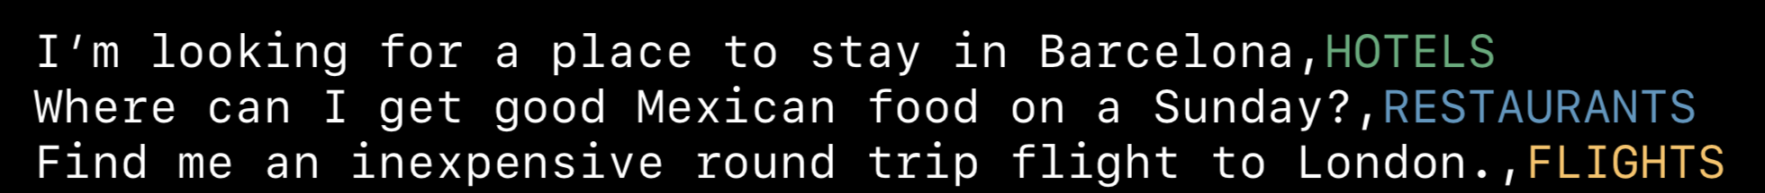
Analysis the topic of a sentence

Slide 15
Positive Post App
Demo App similar to WWDC 18

Slide 16
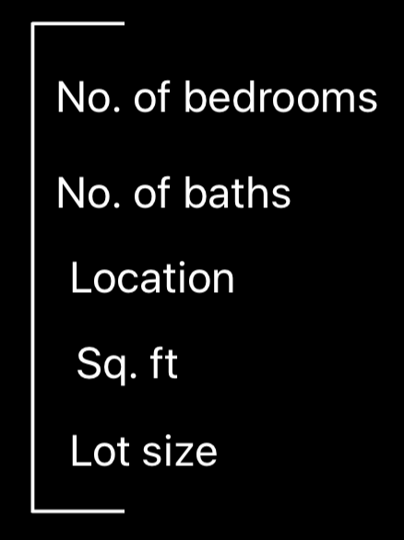
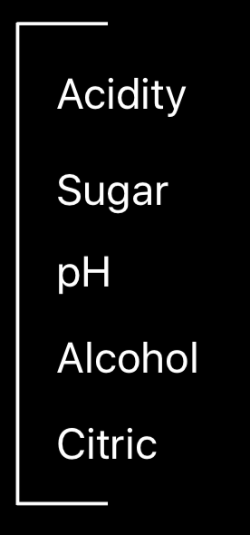
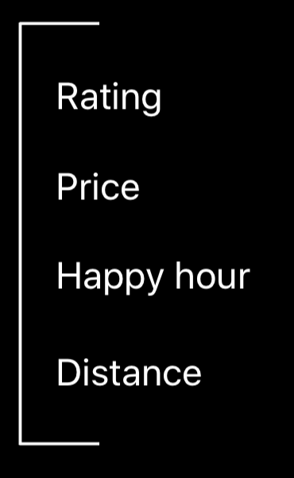
Tabular data analysis
From WWDC18, you can use this model to analyze wine.
Base from your data, you can get an output of prediction.
House Value
Wine
Find a bar

Slide 17
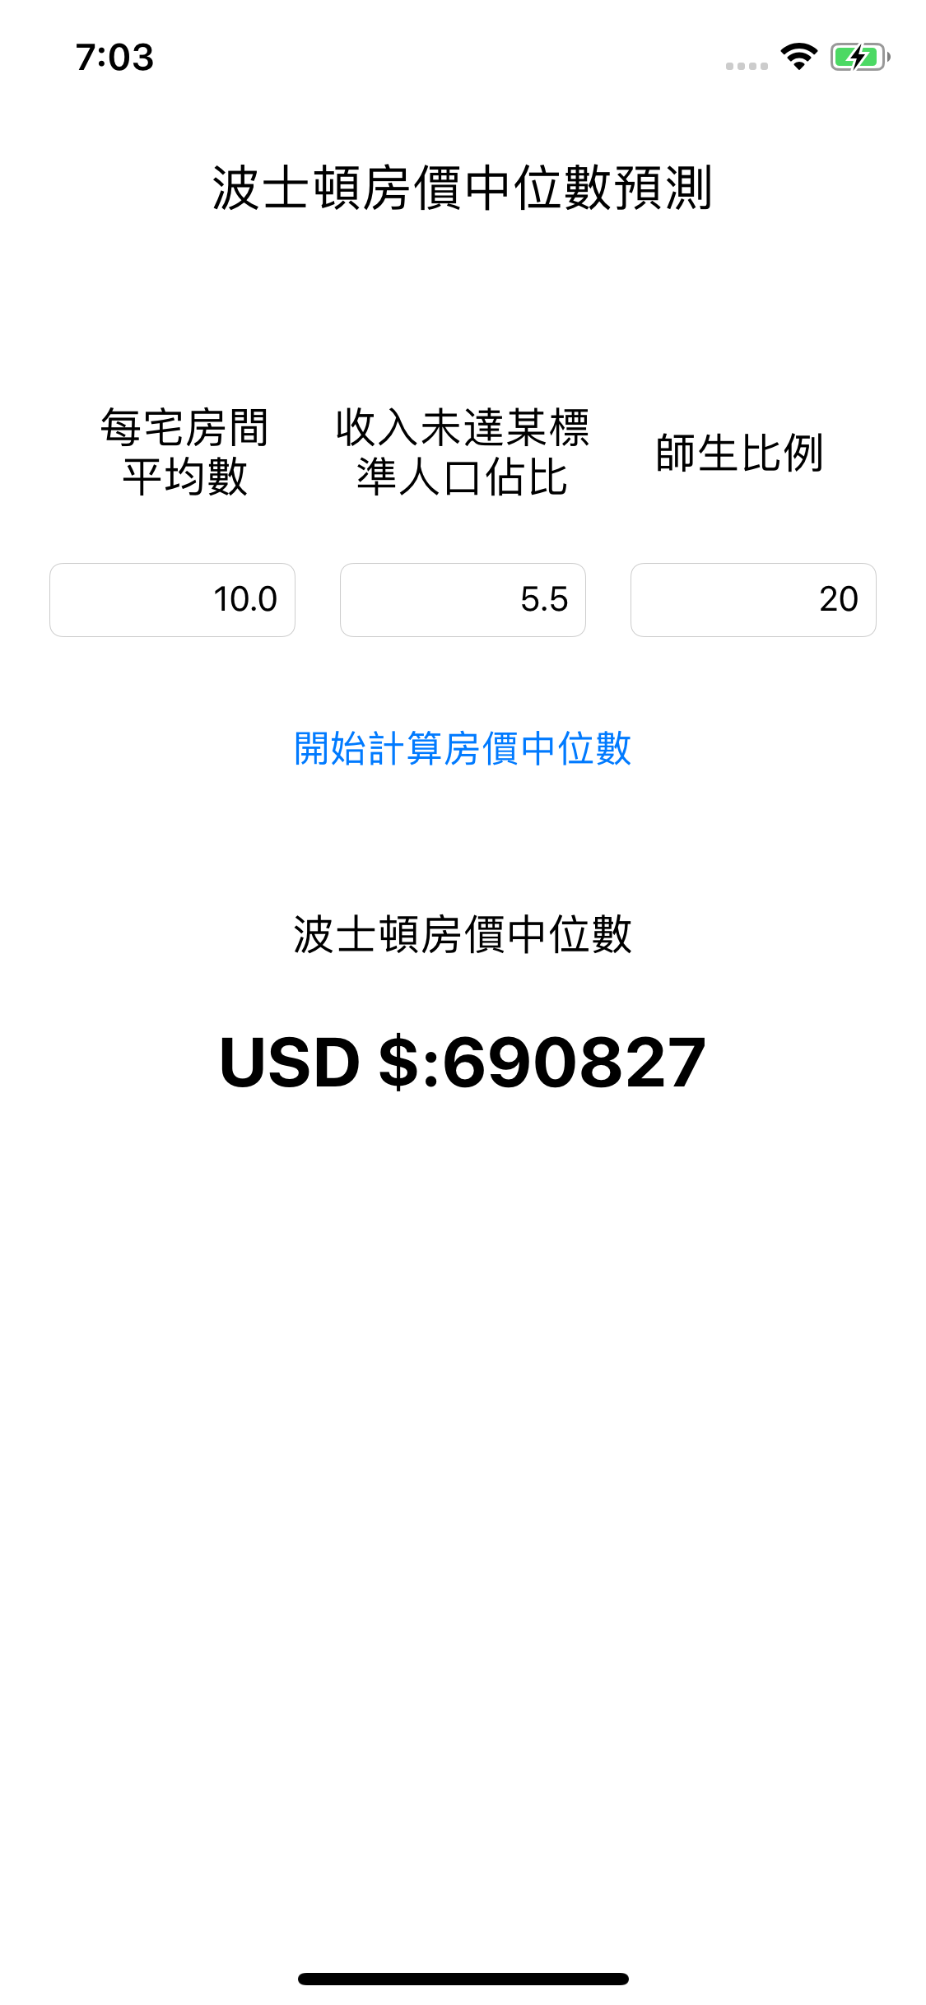
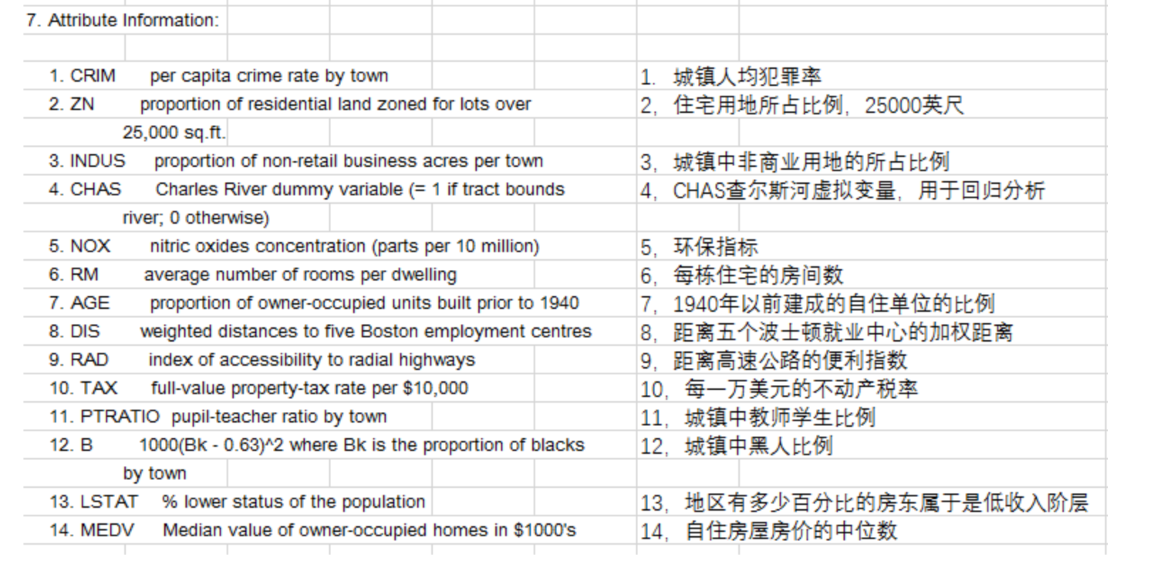
`
Base from input data, you can get median value of owner-occupied homes.

Slide 18
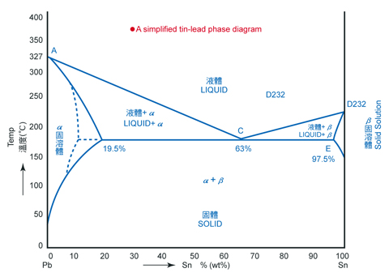
Actually, some data can be analyzed without ML model
After you got data, you can try D.O.E method or Takuchi method firstly.
You can also search history data by Google Scholar firstly.

Slide 19
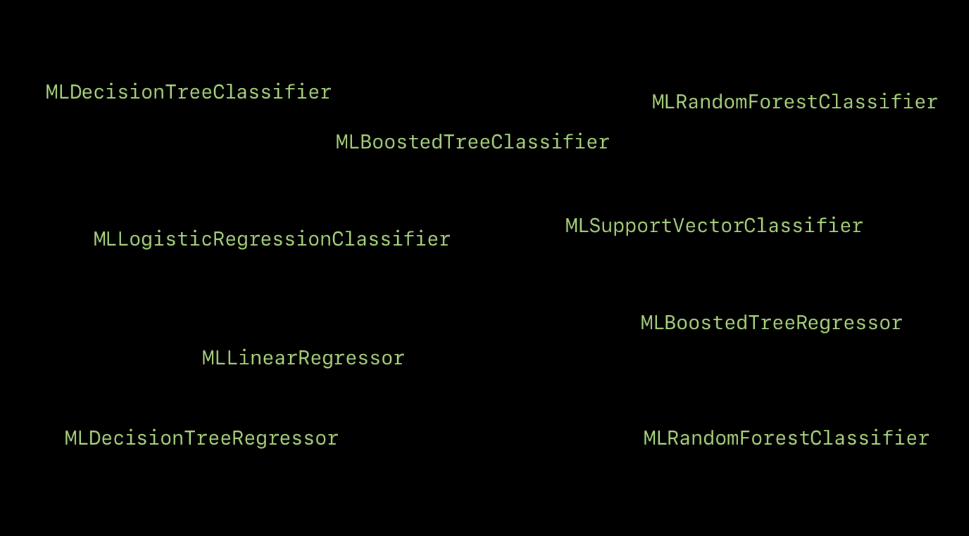
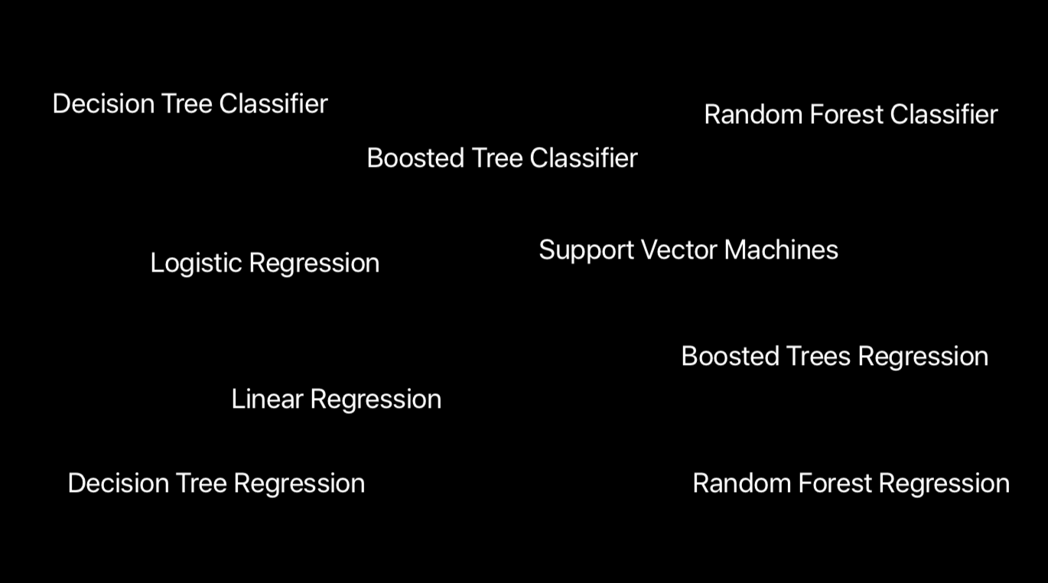
CreateML can choose an algorithm from data

Slide 20
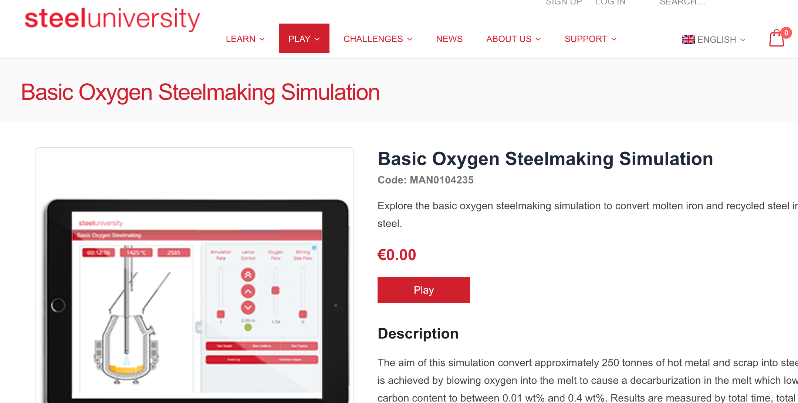
If you don’t have a production line, you can use simulator to try CreateML
Catapult simulator 2 https://www.geogebra.org/m/AHYnuZ8s
Steel University https://steeluniversity.org
Catapult simulator 1 http://www.virtualtrebuchet.com/

Slide 21
Keywords of Machine Learning
Create ML’s methods is close to this part
Monte Carlo method
Tensor Flow
CNN
Reinforcement Learning
NLP
Model Free
Q learning
Model-based
Policy

Slide 22
Awesome CoreML GitHub Repo
If you just want to try CoreML module, you can just download models from these repositories.
https://github.com/likedan/Awesome-CoreML-Models
https://github.com/SwiftBrain/awesome-CoreML-models

Slide 23
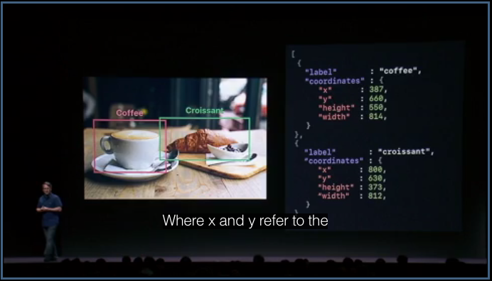

Turi Create’s coordinator system

Slide 24
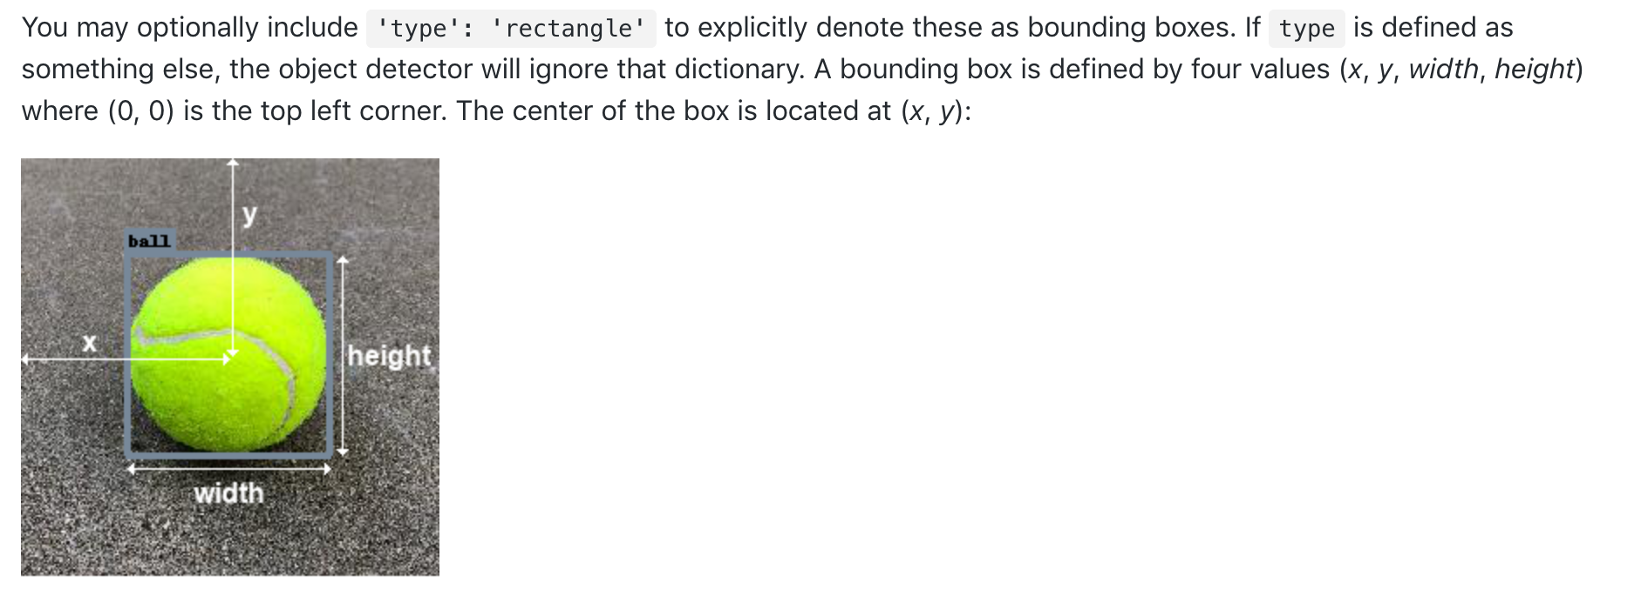
Turi Create’s coordinator system

Slide 25
GitHub - This Keynote and Projects
https://goo.gl/H9cVK9

